Slide 1
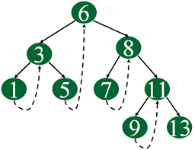
Threaded Binary Trees
.

Slide 2
Threaded Binary Trees
According to this idea we replace all the null pointers by the appropriate pointer values called threads.

Slide 3
Some Properties of BT
The maximum number of nodes with height h of a binary tree is 2^{h+1}-1.
For any nonempty binary tree, T,
if n0 is the number of leaf nodes and
n2 the number of nodes of degree 2,
then n0=n2+1

Slide 4
Threaded Binary Trees
Two many null pointers in binary trees (skewed tree)
n: number of nodes
number of non-null links: n-1
total links: 2n
null links: 2n-(n-1)=n+1
Replace these null pointers with some useful “threads”.

Slide 5
Inorder Traversal (recursive version)
void inorder(tree_pointer ptr)
/* inorder tree traversal */
{
if (ptr) {
inorder(ptr->left_child);
printf(“%d”, ptr->data);
inorder(ptr->right_child);
}
}
A / B * C * D + E

Slide 6
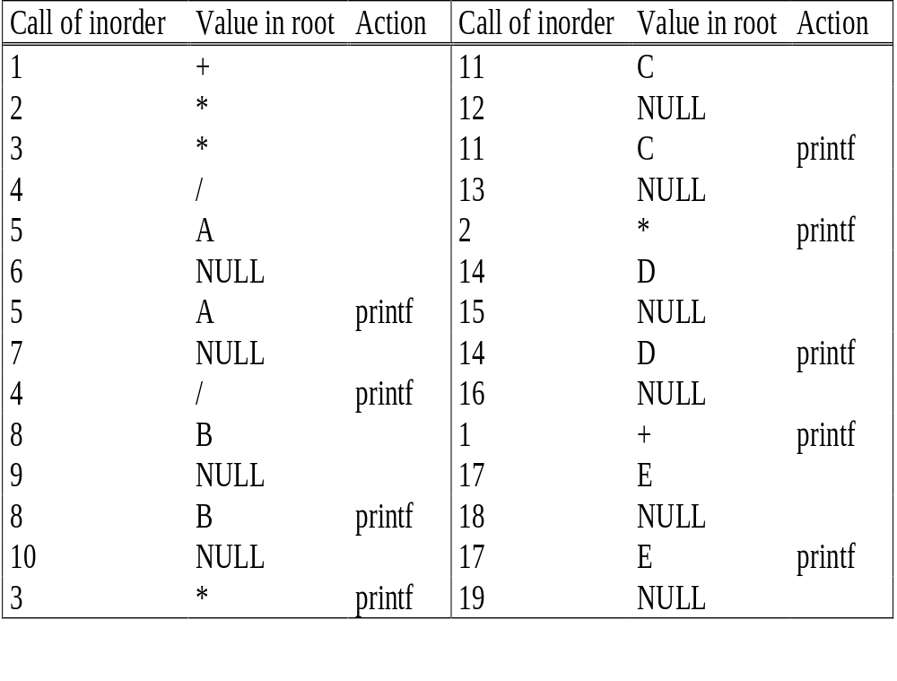
void inorder(tree_pointer ptr)
/* inorder tree traversal */
{
if (ptr) {
inorder(ptr->left_child);
printf(“%d”, ptr->data);
inorder(ptr->right_child);
}
}
Trace Operations of
Inorder Traversal
+
*
E
*
D
/
C
A
B
A / B * C * D + E

Slide 7
Threaded Trees
Binary trees have a lot of wasted space: the leaf nodes each have 2 null pointers
We can use these pointers to help us in inorder traversals
We have the pointers reference the next node in an inorder traversal; called threads
We need to know if a pointer is an actual link or a thread, so we keep a boolean for each pointer

Slide 8
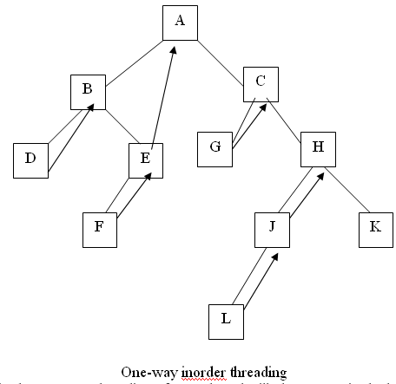
Threaded Binary Tree (TBT)
There exist two types of TBT
one-way threading
two-way threading.
Threaded Binary Tree One-Way
thread appear in the right field of a node
thread point to the next node in the in-order traversal of T.
Inorder of tree is:
D,B,F,E,A,G,C,L,J,H,K

Slide 9
Threaded Binary Tree Two-Way
If ptr->left_child is null,
replace it with a pointer to the node that would be
visited before ptr in an inorder traversal
(inorder predeccessor)
If ptr->right_child is null,
replace it with a pointer to the node that would be
visited after ptr in an inorder traversal
(inorder successor)

Slide 10
Threaded Binary Tree Two-Way…..continued
root
A
dangling
B
C
dangling
D
E
F
G
H
I
inorder traversal:
H, D, I, B, E, A, F, C, G

Slide 11
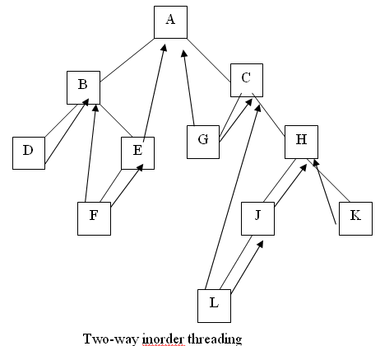
Threaded Binary Tree Two-Way…..continued
In two-way threading of T.
A thread will also appear in the left field of a node and will point to the preceding node in the in-order traversal of tree T.
the left pointer of the first node and the right pointer of the last node (in the in-order traversal of T) will contain the null value when T does not have a header node.

Slide 12
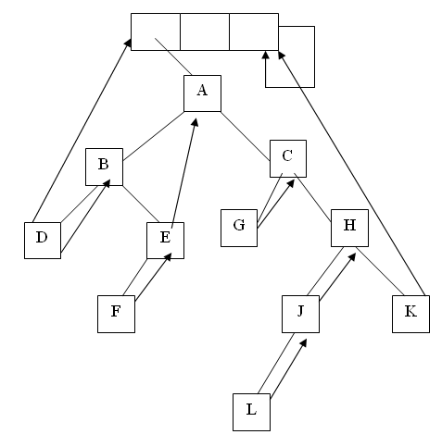
Threaded Binary Tree Two-Way

Slide 13
Node Structure for Threaded BT
left_thread left_child data right_child right_thread
TRUE
●
●
FALSE
TRUE: thread
FALSE: child
class Node {
int data;
Node * left_child, * right_child;
boolean leftThread, rightThread;
}

Slide 14
Memory Representation of a Threaded BT
root
A
threaded_pointer insucc(threaded_pointer tree)
{
threaded_pointer temp;
temp = tree->right_child;
if (!tree->right_thread)
while (!temp->left_thread)
temp = temp->left_child;
return temp;
}
dangling
B
C
dangling
D
E
F
G
H
I
root
--
f
f
f
A
f
f
B
f
f
C
f
f
D
f
t
E
t
t
F
t
t
G
t
t
H
t
t
I
t

Slide 15
Advantages of threaded binary tree:
Threaded binary trees have numerous advantages over non-threaded binary trees listed as below:
The traversal operation is more faster than that of its unthreaded version, because with threaded binary tree non-recursive implementation is possible which can run faster and does not require the botheration of stack management.
We can efficiently determine the predecessor and successor nodes starting from any node. In case of unthreaded binary tree, however, this task is more time consuming and difficult.
  Any node can be accessible from any other node. Threads are usually move to upward whereas links are downward. Thus in a threaded tree, one can move in their direction and nodes are in fact circularly linked. This is not possible in unthreaded counter part because there we can move only in downward direction starting from root.

Slide 16
Disadvantages of threaded binary tree:
  Insertion and deletion from a threaded tree are very time consuming operation compare to non-threaded binary tree.
  This tree require additional bit to identify the threaded link.

Slide 17
Inorder Traversal of Threaded BT
void tinorder(threaded_pointer tree)
{
/* traverse the threaded binary tree inorder */
threaded_pointer temp = tree;
for (;;) {
temp = insucc(temp);
if (temp==tree) break;
printf(“%d”, temp->data);
}
}
O(n)
threaded_pointer insucc(threaded_pointer tree)
{
threaded_pointer temp;
temp = tree->right_child;
if (!tree->right_thread)
while (!temp->left_thread)
temp = temp->left_child;
return temp;
}

Slide 18
Next Node in Threaded BT
threaded_pointer insucc(threaded_pointer tree)
{
threaded_pointer temp;
temp = tree->right_child;
if (!tree->right_thread)
while (!temp->left_thread)
temp = temp->left_child;
return temp;
}

Slide 19
Node Insertion in Threaded Binary Tree

Slide 20
Insertion
It’s a little more complicated to insert a new node into a threaded BST than into an unthreaded one.
We must set the new node's left and right threads to point to its predecessor and successor, respectively

Slide 21
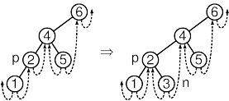
Suppose that new node n is the right child of its parent p. This means that
p is n's predecessor, because n is the least node in p's right subtree.
n's successor is therefore the node that was p's successor before n was inserted, ie, it is the same as p's former right thread.

Slide 22
Examples
Insert a node D as a right child of B.
struct Node {
struct Node *left, *right;
int info;
boolean lthread, rthread;
};
root
root
A
A
(1)
parent
B
parent
B
(3)
child
child
C
D
C
D
(2)
empty

Slide 23
Inserting Node into
Threaded BTs
A
(1)
parent
B
(3)
C
D
child
(2)
Insert child as the right child of node parent
  change parent->right_thread to FALSE
  set child->right_child to
  parent->right_child
  set child->left_child to point to parent
  change parent->right_child to point to child
  set child->left_thread and
  child->right_thread to TRUE

Slide 24
When new node is inserted as the right child
1 par -> rthread = false;
2 tmp -> right = par -> right;
3 tmp -> left = par;
4 par -> right = tmp;
5 tmp -> rthread = true;
5 tmp -> lthread = true;
BST 12, 5 , 21, 2, 7, 22
Insert 9
Insert child as the right child of node parent
  change parent->right_thread to FALSE
  set child->right_child to
  parent->right_child
  set child->left_child to point to parent
  change parent->right_child to point to child
  set child->left_thread and
  child->right_thread to TRUE

Slide 25
When new node inserted as the left child
BST 12, 5 , 21, 2, 7, 21, 22
Insert 6
When new node is inserted as the right child
1 par -> rthread = false;
2 tmp -> right = par -> right;
3 tmp -> left = par;
4 par -> right = tmp;
5 tmp -> rthread = true;
5 tmp -> lthread = true;
When new node is inserted as the left child ?
1 par -> lthread = false;
2 tmp -> left = par -> left;
3 tmp -> right = par;
4 par -> left = tmp;
5 tmp -> rthread = true;
5 tmp -> lthread = true;

Slide 26
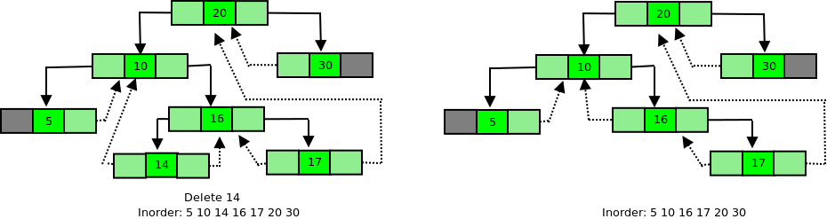
Node Deletion
in
Threaded Binary Tree

Slide 27
Case 1: Leaf Node need to be deleted
In BST, for deleting a leaf Node the left or right pointer of parent was set to NULL.
In Threaded tree, instead of setting the pointer to NULL it is made a thread.
Node is the left child of a Parent
left pointer of parent should become a thread pointing to its predecessor of the parent Node after deletion.
par -> lthread = true;
par -> left = ptr -> left;

Slide 28
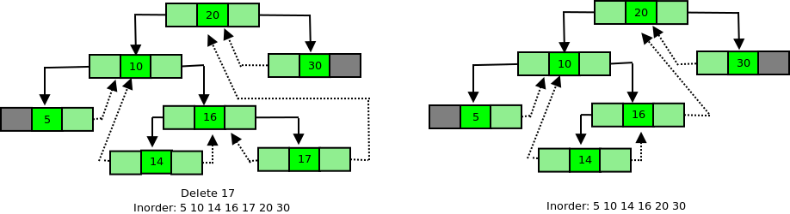
Case 1: Leaf Node need to be deleted
In BST, for deleting a leaf Node the left or right pointer of parent was set to NULL.
In threaded tree, instead of setting the pointer to NULL it is made a thread.
Node is the right child of a Parent
right pointer of parent should become a thread pointing to its successor of the parent Node after deletion.
par -> rthread = true;
par -> right = ptr -> right;

Slide 29
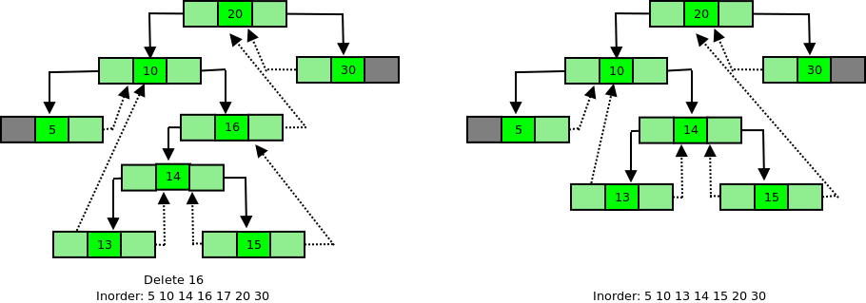
Case 2: Node to be deleted has only one child
After deleting the Node as in a BST, the inorder successor and inorder predecessor of the Node are found out.
s = inSucc(ptr);
p = inPred(ptr);
If Node to be deleted has left subtree
then after deletion right thread of its predecessor should point to its successor.
p->right = s; or p->right = ptr->right
par-> child link = ptr -> child link

Slide 30
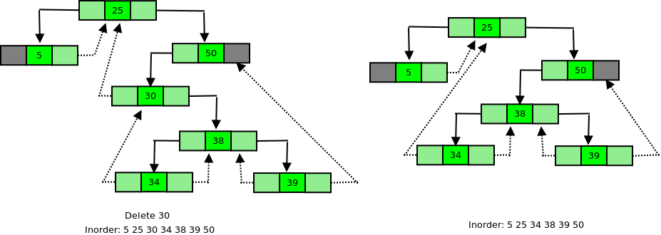
Case 2: Node to be deleted has only one child
After deleting the Node as in a BST, the inorder successor and inorder predecessor of the Node are found out.
s = inSucc(ptr);
p = inPred(ptr);
If Node to be deleted has right subtree
then after deletion left thread of its successor should point to its predecessor.
s->left = p; or s->left = ptr->left;
par-> child link = ptr -> child link

Slide 31
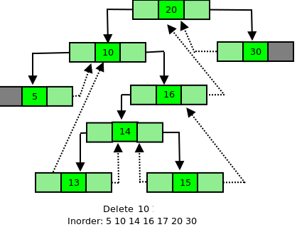
Case 3: Node to be deleted has two children
We find inorder successor of Node ptr (Node to be deleted) and then copy the information of this successor into Node ptr.
After this inorder successor Node is deleted in right subtree using either Case 1 or Case 2.

Slide 32
Case 1: Leaf Node need to be deleted
Node is the right child of a Parent
Node is the left child of a Parent
par -> rthread = true;
par -> right = ptr -> right;
par -> lthread = true;
par -> left = ptr -> left;
Case 2: Node to be deleted has only one child
s = inSucc(ptr);
p = inPred(ptr);
If Node to be deleted has right subtree
left thread of its successor should point to its predecessor.
s->left = p; or s->left = ptr->left;
par-> child link = ptr -> child link
If Node to be deleted has left subtree
then after deletion right thread of its predecessor should point to its successor.
p->right = s; or p->right = ptr->right
par-> child link = ptr -> child link

Slide 33

Case 1: Leaf Node need to be deleted
Node is the right child of a Parent
Node is the left child of a Parent
par -> rthread = true;
par -> right = ptr -> right;
par -> lthread = true;
par -> left = ptr -> left;
Case 2: Node to be deleted has only one child
s = inSucc(ptr);
p = inPred(ptr);
If Node to be deleted has right subtree
left thread of its successor should point to its predecessor.
s->left = p; or s->left = ptr->left;
par-> child link = ptr -> child link
If Node to be deleted has left subtree
tright thread of its predecessor should point to its successor.
p->right = s; or p->right = ptr->right
par-> child link = ptr -> child link

Slide 34
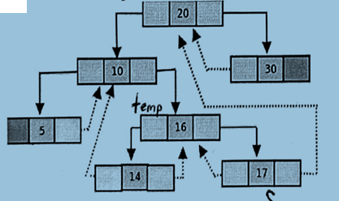
Write the required statements to delete 16 using successor (i.e. right subtree)

Slide 35
Write the required statements to delete 16 using successor (i.e. right subtree)
temp → data = s → data
temp → rthread = true
temp → right = s → right
delete s

Slide 36
// Returns inorder successor
struct Node* inSucc(struct Node* ptr)
{
if (ptr->rthread == true)
return ptr->right;
ptr = ptr->right;
while (ptr->lthread == false)
ptr = ptr->left;
return ptr;
}
Inorder of tree is:
D,B,F,E,A,G,C,L,J,H,K
// Returns inorder predecessor
struct Node* inPred(struct Node* ptr)
{
if (ptr->lthread == true)
return ptr->left;
ptr = ptr->left;
while (ptr->rthread == false)
ptr = ptr->right;
return ptr;
}

Slide 37
Summary
A threaded binary tree is a tree that maintains the predecessor and successor node of every node in the tree
If the right child of a node is NULL, the right pointer of that node points to the inOrder successor of the node
If the left child of a node is NULL, the left pointer of that node points to the inOrder predecessor of the node
if a tree maintains just the right successor information with its nodes, it is a single threaded binary tree
If the tree maintains both the successor and predecessor information, it is a double threaded binary tree
In the node structure, we maintain a boolean field that tells whether the left or right pointer is pointing to a child node or a parent node
A threaded binary tree lets us perform traversal, insertion, deletion and search operations without using any extra space
The time complexity of these operations in worst case remains O(n)

Slide 38
Video Lecture of the topic can be found at
Threaded Binary Tree – Fundamentals
https://youtu.be/e_IliqHYIu8
Adding Node in Threaded Binary Tree
https://youtu.be/dbXrAL_gBUY
Deleting a Node in Threaded Binary Tree
https://youtu.be/xexyg4XfgJg

